Slide 1
Support Vector
Machines
Primal Formulation, Margins, Application to Parkinson’s Disease
Emma Chang
Notes:
Hi everyone, I'm Emma. Today I'm going to talk about Support Vector Machines, specifically about primal formulations and the margins. then Ill show a quick application to predicting Parkinson's disease from brain health data."

Slide 2
What is a Support Vector Machine?
①
Find a hyperplane separating the two classes
support
vectors
②
SVM picks the one with the maximum margin
③
Support vectors = nearest points
No PD
max margin
PD
Bigger margin → better generalization to new patients
Notes:
So the main idea of a SVM is simple. We want to draw a line that separates two groups. In the parkinson example, PD patients on one side, no PD on the other. There are an infinite amount of lines that can do this. But SVM finds the line with the maximum margin. The margin is the gap between the boundary of the nearest points on each side. Those nearest points are called the support vectors. They're the only points that matter for defining where the hyperplane goes. The key idea is that a bigger margin means the model generalizes better to new patients it hasn't seen before.
maximum margin?n- it puts the boundary as far as possible from all the training patients on both sides, giving future patients the maximum amount of room to still be correctly classified.

Slide 3
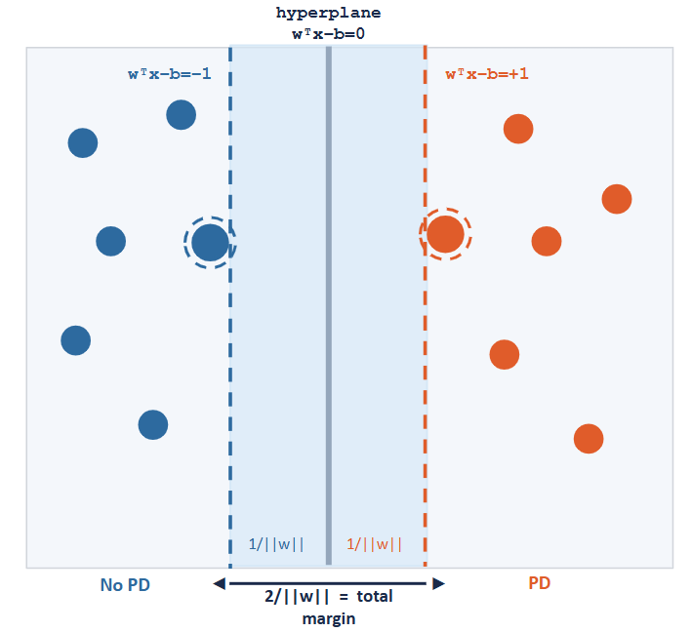
Primal Formulation — Hard Margin
Assumes classes are perfectly linearly separable
wᵀx−b=−1
wᵀx−b= 0
wᵀx−b=+1
minimize
½ ||w||²
subject to
yᵢ(wᵀxᵢ−b) ≥ 1
wᵀxᵢ−b
hyperplane eq. for patient i
positive = PD, negative = no PD
yᵢ
+1 if PD, −1 if no PD
≥ 1
forces patients outside the margin boundary, not just the correct side
2 / ||w||
Margin = 2/||w||
1/||w||
1/||w||
◄
►
2/||w|| = margin
No PD
PD
Notes:
So the main goal of SVM is: Find the w that minimizes ½||w||² with the condition that every single patient satisfies yᵢ(wᵀxᵢ − b) ≥ 1I'm going to talk about the hard margin first, which assumes the classes are perfectly linearly separable. The equation for the hyperplane is wᵀx minus b equals zero. It’s the same as a line in 2D but extended to higher dimensions. We define the two margin boundaries on either side as wᵀx minus b equals plus one and minus one. These are the two dashed lines. The constraint is yᵢ times wᵀxᵢ minus b must be at least one for every patient. this forces every patient to be on the correct side of their margin boundary, not just the correct side of the hyperplane. And the margin width works out to 2 over the length of w, which ill show you on the next slide
why +1, -1: This is a convention, we're essentially choosing our units so the boundaries sit at plus and minus one, which we can always do by rescaling w.
what is wt? w and x are both column vectors — imagine a list of numbers standing upright. The issue is you can't directly multiply two column vectors in linear algebra, the dimensions don't line up. So we transpose w, which just means we tip it on its side into a row vector. Then wᵀx is a row times a column, which works out to a single number — w₁x₁ plus w₂x₂ plus w₃x₃ and so on for all features. It's identical to the dot product w·x that you might have seen before, just written in matrix notation
multiply so it becomes positive (y is the actual value, wx + b is the predicted value)..
if the value is + and our predictions + → then we git positive which is greater than 1
if the value is - and our prediction is - same as above
but if value is - and our predictions wrong → negative so it doesnt fit the constraint and we will ignore it
||w|| is the length of w = sqrt(w1^2 + w2^2….)

Slide 4
Where does Margin = 2 / ||w|| come from?
Two margin planes (by convention ±1)
wᵀx−b = +1 and wᵀx−b = −1
Distance between two parallel planes
|c₁−c₂| / ||w|| = |+1−(−1)| / ||w|| = 2/||w||
We want to maximize the margin
maximize 2/||w||
Flip the fraction (equivalent)
minimize ||w||
Drop the square root (equivalent)
minimize ||w||²
Add ½ for a clean derivative
minimize ½||w||² ✓
Notes:
So where does 2 / ||w|| actually come from? The two margin boundaries are wᵀx minus b equals plus one and minus one — those are our two parallel planes. There's a formula (from geometry) that says the distance between two parallel planes is the absolute difference of their constants divided by the length of w. Plugging in plus one and minus one gives us the absolute value of plus one minus negative one over ||w||, which is 2 over ||w||. So to maximize the margin we want to maximize 2 over ||w||. Maximizing 2 over ||w|| is the same as minimizing ||w|| (the denominator) Then we square it to drop the square root, which makes it easier to differentiate. And we add a half so the derivative comes out cleanly as w instead of 2w.

Slide 5
Primal Formulation — Soft Margin
Real data is messy — classes overlap. Hard margin has no solution.
Hinge loss ζᵢ
Soft margin objective
ζᵢ = max(0, 1 − yᵢ(wᵀxᵢ − b))
minimize ||w||² + C·(1/n)Σζᵢ
ζᵢ = 0 → correct, no penalty
subject to yᵢ(wᵀxᵢ−b) ≥ 1−ζᵢ, ζᵢ ≥ 0
ζᵢ > 0 → violation, penalty = distance inside margin
Two costs: big margin (shrink ||w||²) vs pay fines (C·Σζᵢ)
The C tradeoff
C large
violations expensive → strict boundary, small margin → risk of overfitting
C small
violations cheap → relaxed boundary, large margin → better generalization
C = 1
default middle ground
Notes:
In real life, data is messy. PD and no PD patients overlap and no perfect separating line exists. So we allow some violations and this is called the soft margin. For each patient we define a variable zeta using the hinge loss. it equals either zero if the patient is correctly classified outside the margin, or it equals how far inside the margin they are if they're violating. We add a penalty C times the sum of all these violations to the objective. So now the solver is minimizing two competing costs , it wants to make the margin as large as possible while also keeping violations small. C controls the tradeoff.
Large C means violations are expensive — strict boundary, small margin, risk of overfitting. Small C means violations are cheap — relaxed boundary, larger margin. We used C equals one, the default middle ground."
slack variable: A slack variable ζᵢ is just a number that measures how much a specific patient is allowed to "slack off" from the hard margin constraint

Slide 6
Application: Predicting Parkinson's Disease
~2,714
62
1,024
patients (MrOS)
incident PD cases
(2.3% prevalence)
LHL brain
embedding dims
Does the full 1,024-dim brain embedding predict PD better than the single Brain Health Score?
Model 1 — Baseline
Model 2 — LHL
Covariates + BHS
(8 features)
Covariates + 1,024 LHL features
(1,031 total)
Model | AUC
Covariates + BHS | 0.591 | baseline
Covariates + 1,024 LHL | 0.611 | ▲ +0.02 AUC
Notes:
Here's my application. Im using MrOS and my dataset consists of about 2,714 older men who had sleep studies done. 62 developed Parkinson's disease during follow up. Each patient also has a 1,024-dimensional last hidden layer vector from a deep learning brain health model. The BHS is a single number summarizing brain health, but the model internally produces that richer 1,024-dimensional representation. My question is: does the full embedding predict PD better than the single score
I used a linear SVM specifically because with 1,024 features a linear boundary is usually sufficient and the margin acts as a regularizer for our small case count of 62.

Slide 7
Conclusion
SVM finds the maximum margin hyperplane — hard margin first, then soft margin (slack ζᵢ, penalty C) for real messy data.
Linear SVM is well suited for 1,024-dim data — high dimensions make linear separation easier, and the margin acts as a regularizer.
Result: LHL model (AUC 0.611) > BHS scalar (AUC 0.591) — the full embedding retains signal lost when compressing to one number.
Limitation: only 62 PD cases — results should be interpreted with caution.
Thank you!
Notes:
"To wrap up — SVM finds the maximum margin hyperplane between two classes. The hard margin primal gives us the clean mathematical formulation, and the soft margin extends it to real messy data using slack variables and the penalty C. Linear SVM is particularly well suited for high dimensional data like our 1,024 LHL brain embeddings. And in our application the full embedding modestly outperformed the scalar BHS score, suggesting information is lost in that compression. The main limitation is statistical power — 62 PD cases is small. Thank you, happy to take questions."

